Slide 1
Humanities Centres and
the Digital Humanities
Alan Liu
Australasian Consortium of
Humanities Research Centres
Annual Meeting, July 8, 2013

Slide 2
Humanities Centres and
the Digital Humanities
A. Humanities centres can serve as hubs for digital humanities infrastructural services by . . .

Slide 3
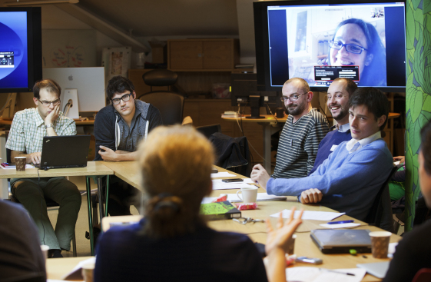
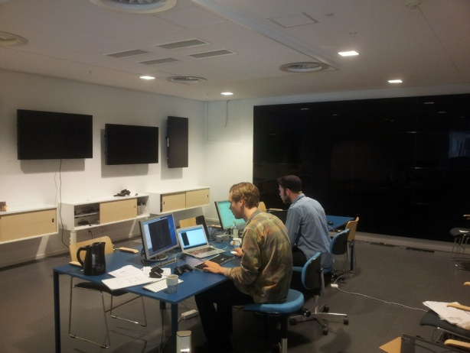
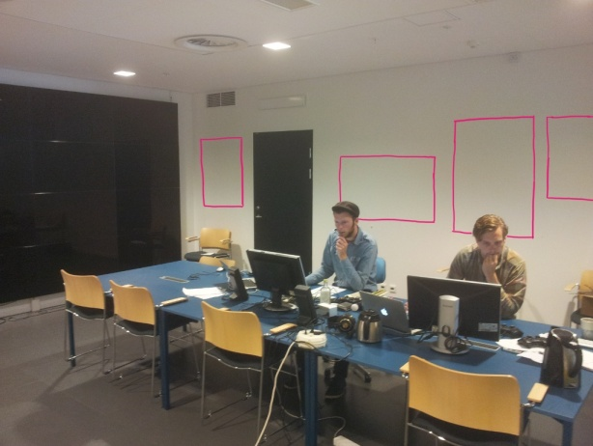
Humanities Centres and
the Digital Humanities
A. Humanities centres can serve as hubs for digital humanities infrastructural services by . . .
Creating state-of-the-art physical & digital infrastructure for international meetings and workshops between humanities centres and cultural institutions.
HUMlab,
Umeå University, Sweden

Slide 4
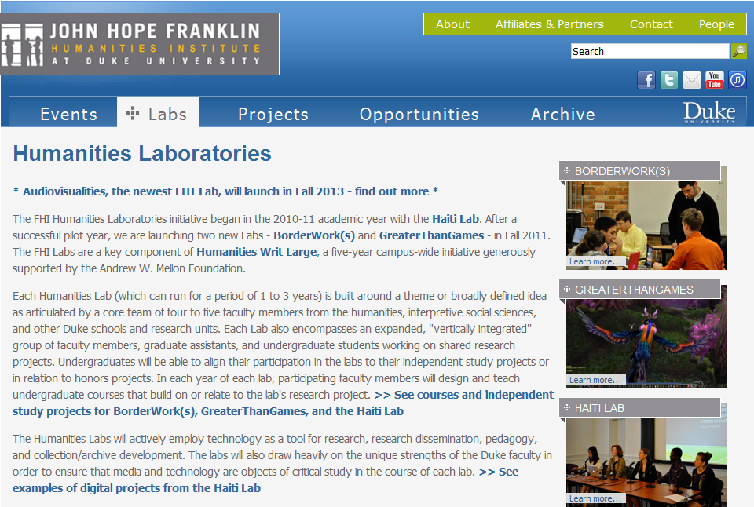
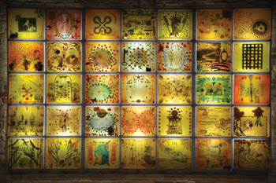
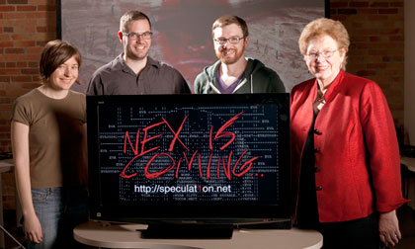
Humanities Centres and
the Digital Humanities
A. Humanities centres can serve as hubs for digital humanities infrastructural services by . . .
Creating incubation programs & spaces for humanities projects and courses with a digital component.
“Humanities Laboratories,” Franklin Institute, Duke U.
“Each Humanities Lab (which can run for a period of 1 to 3 years) is built around a theme or broadly defined idea as articulated by a core team of four to five faculty members from the humanities, interpretive social sciences, and other Duke schools and research units. Each Lab also encompasses an expanded, ‘vertically integrated’ group of faculty members, graduate assistants, and undergraduate students working on shared research projects.”

Slide 5
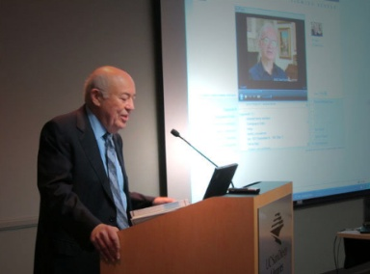
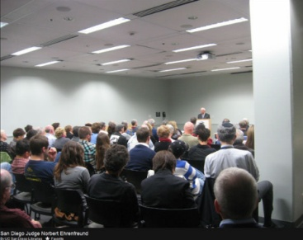
Humanities Centres and
the Digital Humanities
A. Humanities centres can serve as hubs for digital humanities infrastructural services by . . .
Creating innovative hybrid digital/face-to-face events bridging between the academy and the public.
Holocaust Living History Workshop at University of California, San Diego
The Holocaust Living History Workshop connects undergraduate students with local survivors of the Holocaust to train the community in using the USC Shoah Foundation Visual History Archive--a database of 52,000 Holocaust survivor testimonies founded by film maker Steven Spielberg--to experience the history told in the Archive.
​
"Student volunteers have received special training on how to search through the testimonies in the massive Archive, and then teach survivors and their families—from multiple generations—how to use the database."
​
The Workshop also brings local survivors to the library to speak to students in its "Witnessing History" series.

Slide 6
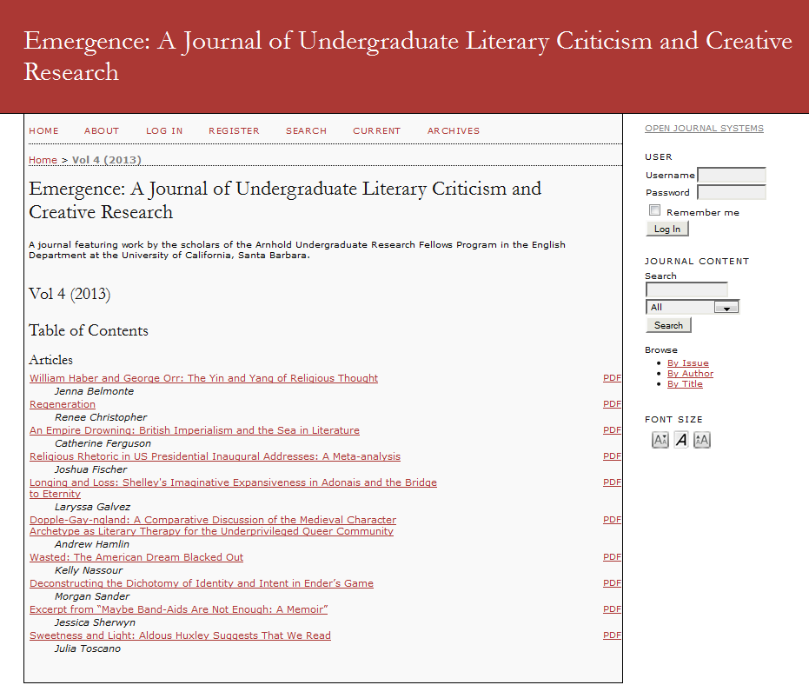
Humanities Centres and
the Digital Humanities
A. Humanities centres can serve as hubs for digital humanities infrastructural services by . . .
Providing digital development, publishing, curation, intellectual-property, and funding services for the humanities (or brokering them with other university providers).
U. California Santa Barbara
English Department
Undergraduate Research Journal
(Published through an Open Journal Systems installation on an English Department server

Slide 7
Humanities Centres and
the Digital Humanities
B. Humanities centres can serve as think tanks for humanities policies in the digital age by . . .

Slide 8
Humanities Centres and
the Digital Humanities
B. Humanities centres can serve as think tanks for humanities policies in the digital age by . . .
Taking the lead in bringing together university library, university press, and other academic agencies to think through the long-term logic of humanities publishing, collection, curation, and reader access services in the digital age.
Social
media
Google, Amazon, etc.
Cultural institutions
?
University Presses
University Libraries
Europeana, DPLA, etc.
Crowdsourcing
(Your Paintings, etc.)
Open Access (OLH, PLOH, etc.)

Slide 9
Humanities Centres and
the Digital Humanities
B. Humanities centres can serve as think tanks for humanities policies in the digital age by . . .
Taking the lead in bringing together humanities researchers, instructors, and students to think about the evolving nature of *intellectual property, *research ethics (human subjects), & *accessibility/disability in the digital age.
What are “fair use” and “plagiarism” in the age of “open,” “collaboration,” and “crowdsourcing”?
Do you need an approved human subjects protocol to show student projects online or to blog an interview with an author?
Can this text box be read through machine-assisted means by the visually impaired? What standards need / should be met?

Slide 10
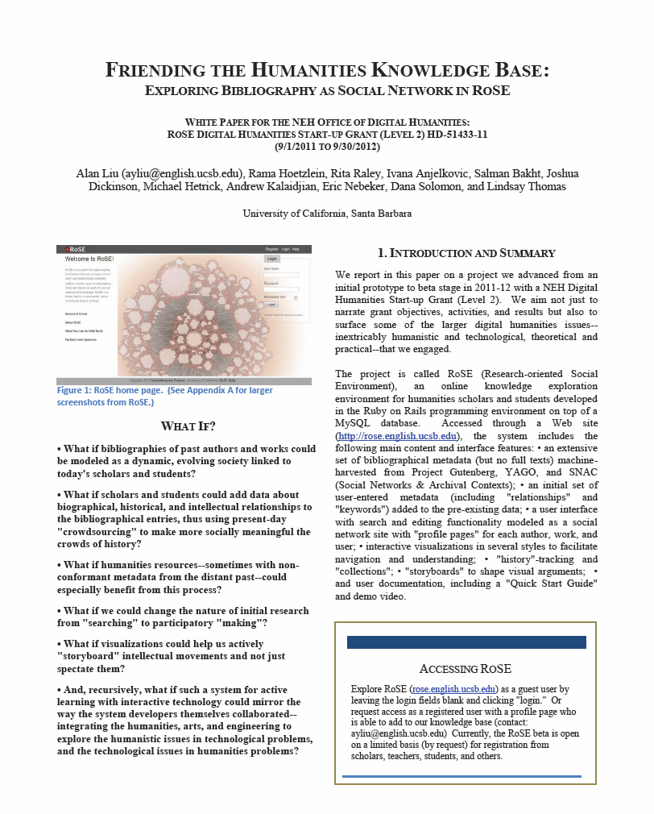
Humanities Centres and
the Digital Humanities
B. Humanities centres can serve as think tanks for humanities policies in the digital age by . . .
Taking the lead in bringing together administrators, faculty, “alt-ac” staff, and graduate students to think through changes in humanities hiring/promotion protocols to accommodate digital work, collaboration, bibliometrics, and “alt-metrics.”

Slide 11
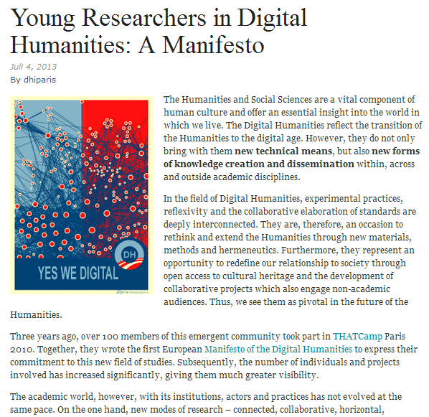
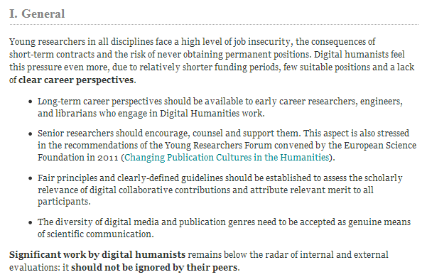
Humanities Centres and
the Digital Humanities
B. Humanities centres can serve as think tanks for humanities policies in the digital age by . . .
Taking the lead in bringing together administrators, faculty, “alt-ac” staff, and graduate students to think through changes in humanities hiring/promotion protocols to accommodate digital work, collaboration, bibliometrics, and “alt-metrics.”
http://dhdhi.hypotheses.org/1855

Slide 12
Humanities Centres and
the Digital Humanities
Alan Liu
Australasian Consortium of
Humanities Research Centres
Annual Meeting, July 8, 2013

